Slide 1
E-commerce in urban areas - problems and delivery challenges on Allegro.pl Jakub Kaczmarski 12.09.2018

Slide 2
Agenda
About needs and choices of Allegro.pl customers - on the example of small and large cities - what problems Clients face, how Allegro.pl wants and can help them and what are the challenges facing the e-commerce market in 2018 and 2019

Slide 3
Introduction
About me
About Allegro
About delivery experience in Allegro (live demo)

Slide 4
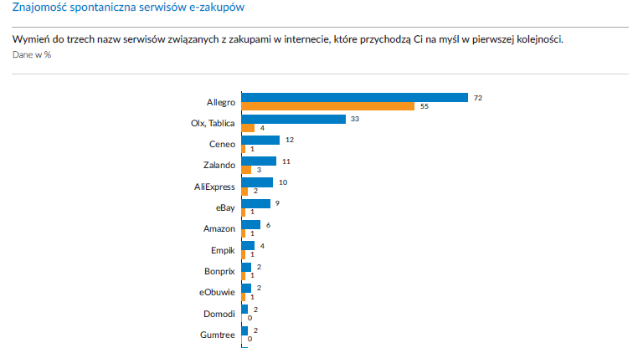
Allegro

Slide 5
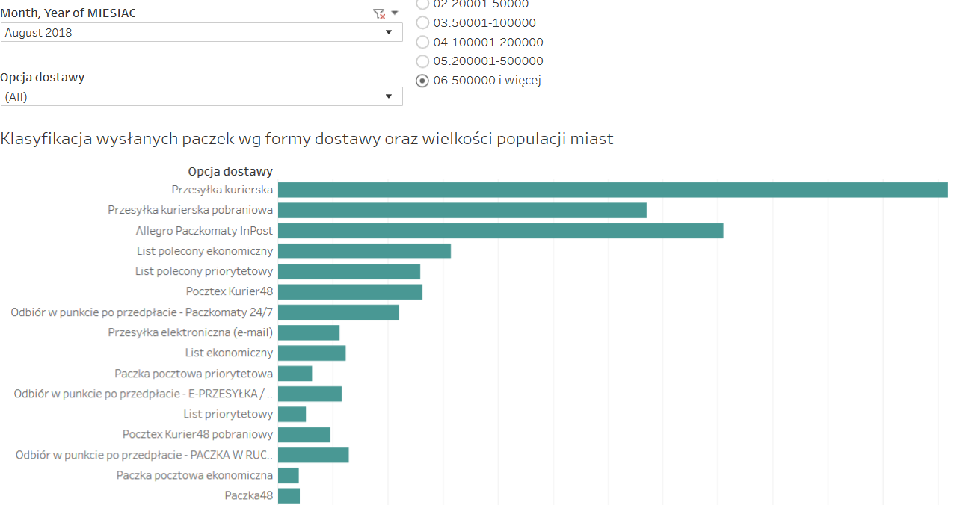
Delivery methods – clients choice

Slide 6
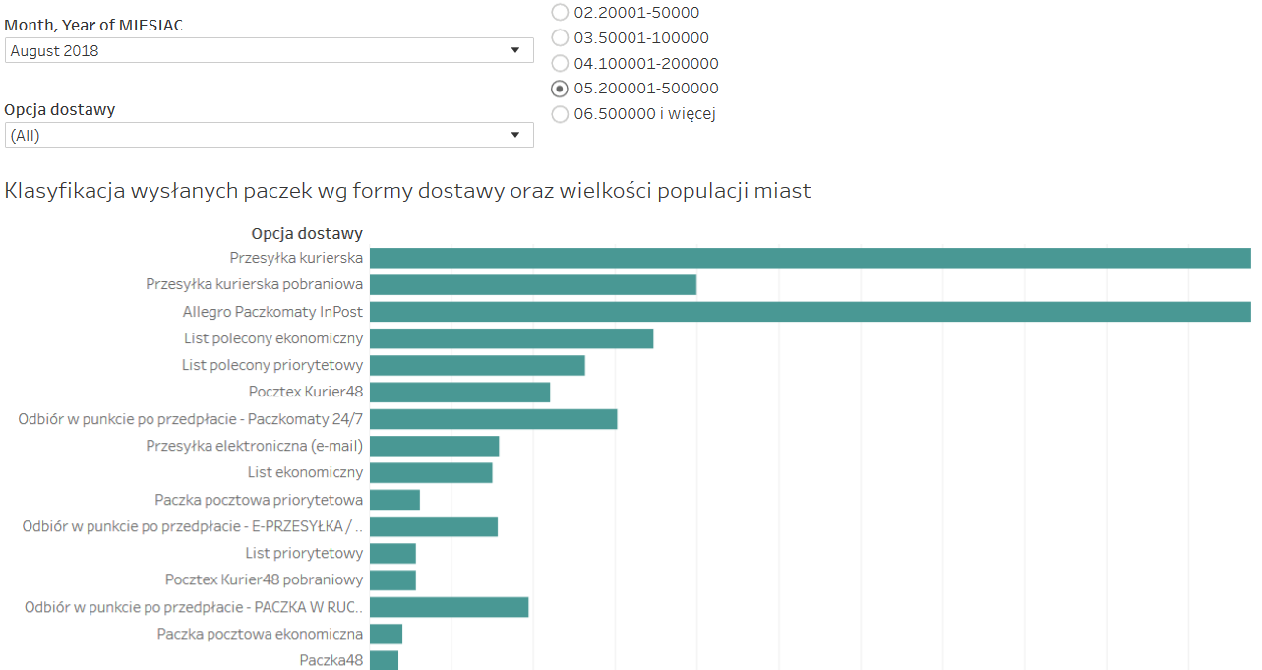
Delivery methods – clients choice

Slide 7
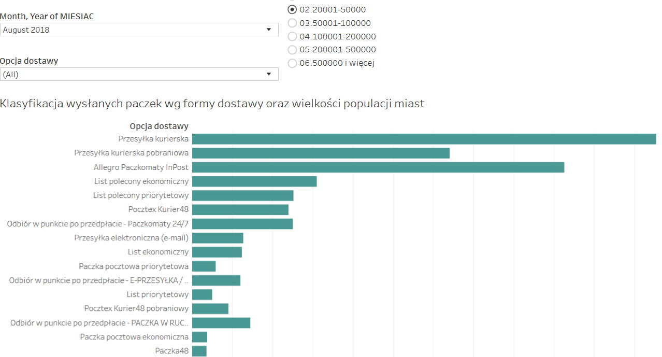
Delivery methods – clients choice

Slide 8
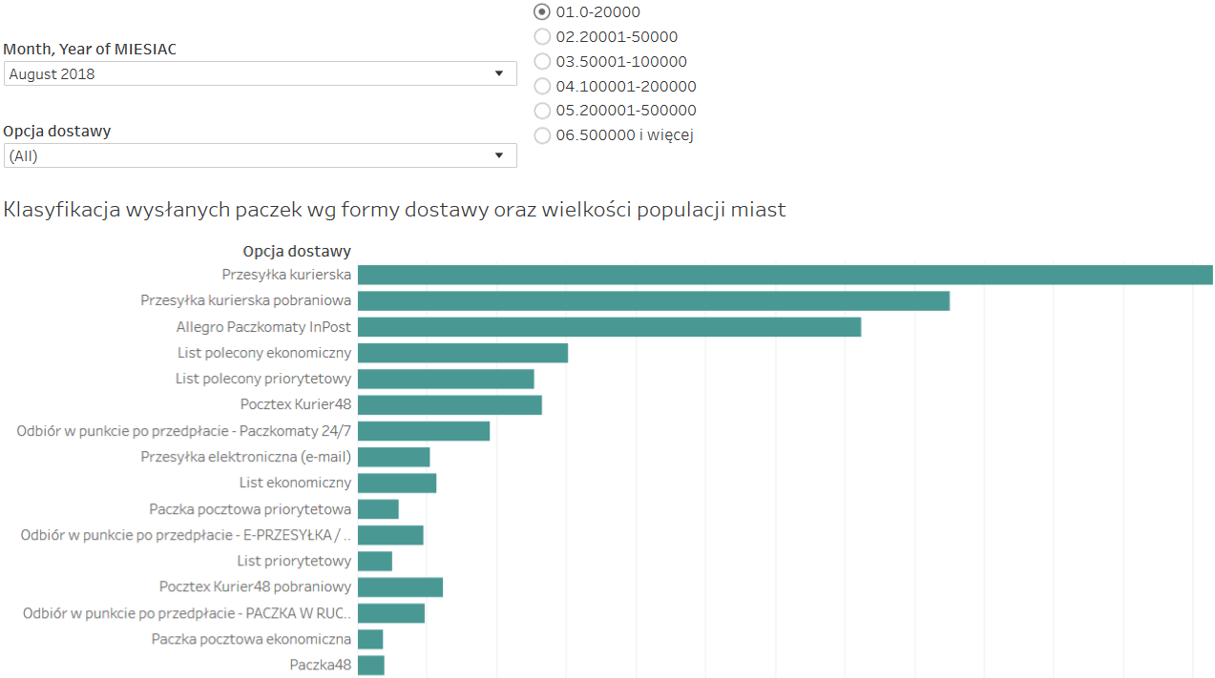
Delivery methods – clients choice

Slide 9
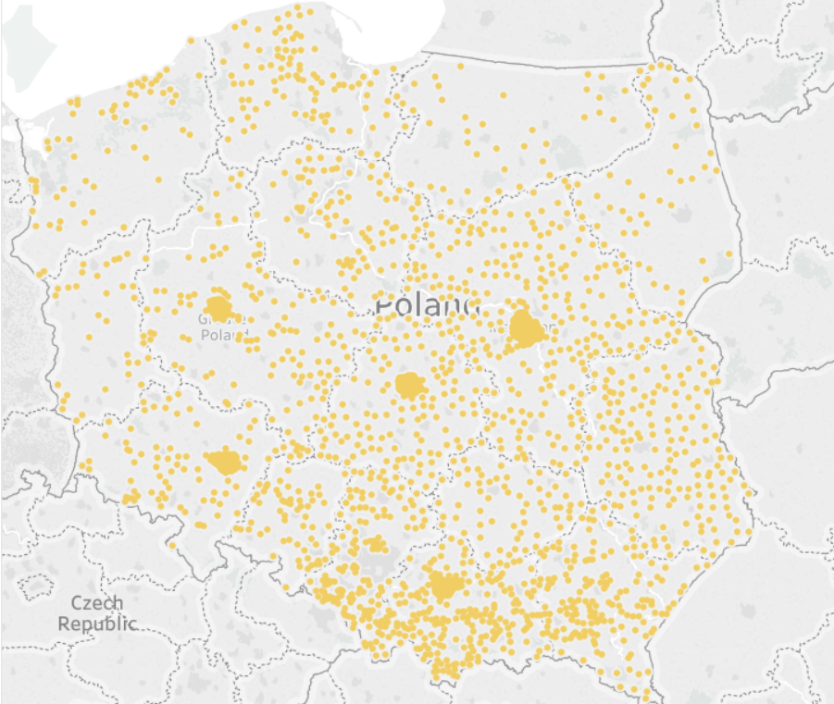
Couriers

Slide 10
Pickup Points and Couriers
Time and place of pickup
More PickUp Points
Last Mile cost
Budling services and shopping with pickup
Large packages
Couriers quality, market saturation

Slide 11
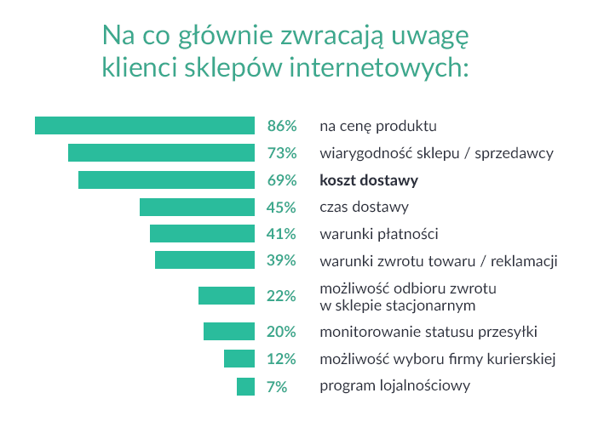
Clients expectations

Slide 12
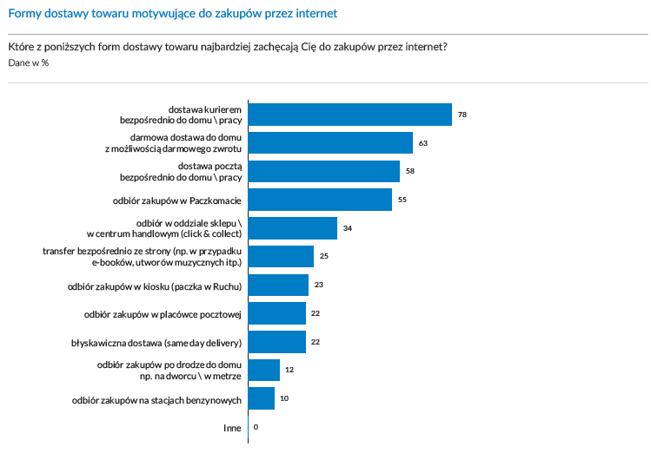
Delivery convinience

Slide 13
Challenges for Allegro
Diversity and quality of merchants
Inconsistent delivery methods – cost of deliveries and different time or quality
Delivery responsibility, Allegro negotation power (?)
Clients diversity – requirements and expectations (be careful of average results)

Slide 14
Allegro Smart!

Slide 15
Future (near)
Free delivery, free returns (?)
Same day delivery in big cities
More Pickup Points, more problems with Couriers, increasing cost of delivery
Delivery standarization vs tailor made delivery
Geolocalization i personalization of delivery

Slide 16
Clients expectations – in cities
Fast delivery – bikes? motors? others?
Restrictions for drones in cities
Courier adjusted to real working hours (evening!)
Delivery on Saturday or Sunday, delivery windows
(Good) cooperation between Courier and Client

Slide 17
How to do this?

Slide 18
Q&A

Slide 19
Thank you.

